Slide 1
YOKOHAMA RACE HISTORY
Elite Analysis · Past 8 Years · April 2026

Slide 2
ELITE MEN

Slide 3
Race Overview — Elite Men
Yokohama
Year | Date | Category | Field | Swim km | Bike km | Run km | Bike Laps | Run Laps
2018 | May 12 | World Championship Series | 48 | nan | nan | nan | — | —
2019 | May 18 | World Championship Series ⚑ | 45 | nan | nan | nan | — | —
2021 | May 15 | World Championship Series ⚑ | 48 | nan | nan | nan | — | —
2022 | May 14 | World Championship Series ⚑ | 45 | 1500.00 | 40000.0 | 10000.0 | 9 | 4
2023 | May 13 | World Championship Series ⚑ | 49 | 1500.00 | 40050.0 | 10000.0 | 9 | 4
2024 | May 11 | World Championship Series | 47 | 1500.00 | 40050.0 | 10000.0 | 9 | 4
2025 | May 17 | World Championship Series ⚑ | 42 | 1500.00 | 37230.0 | 10000.0 | 10 | 4

Slide 4
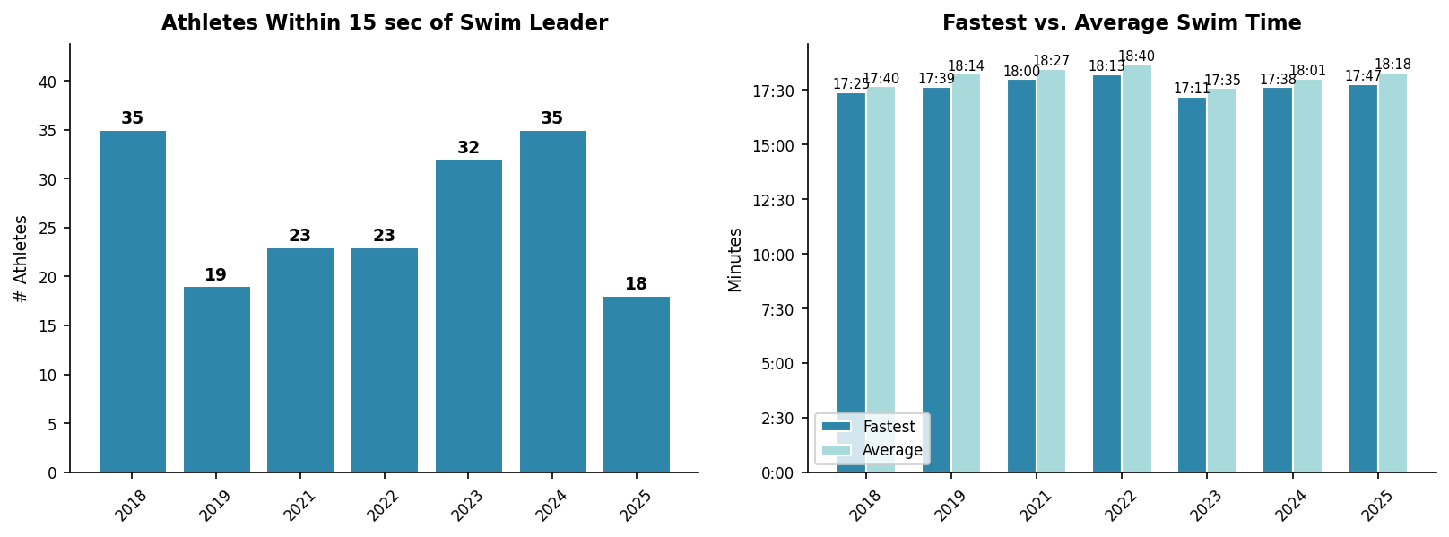
Swim Exit Dynamics — Elite Men
Yokohama

Slide 5
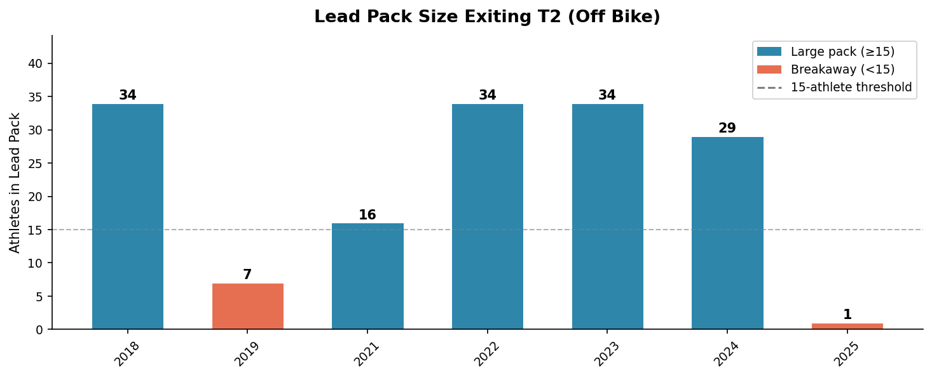
Bike Pack Dynamics — Elite Men
Yokohama

Slide 6
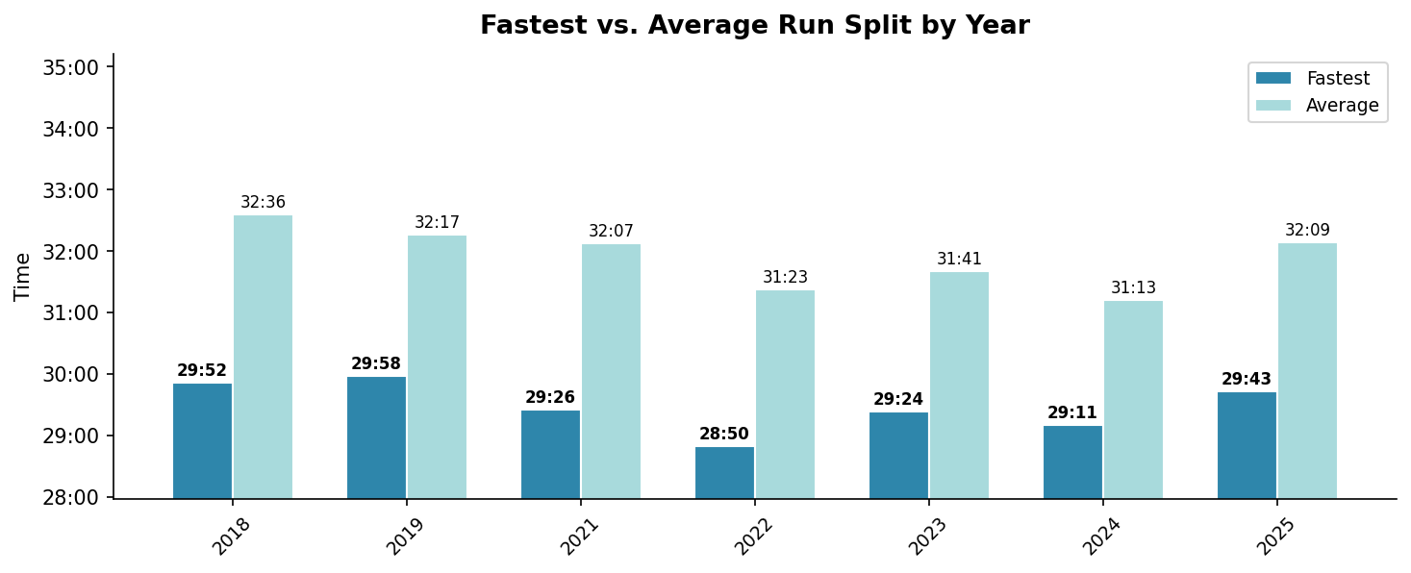
Run Split Analysis — Elite Men
Yokohama

Slide 7
Race Conditions — Elite Men
Yokohama
Year | Air Temp | Water Temp | Wind (km/h) | Wetsuit | Conditions
2018 | 20.1 | — | 9 | — | —
2019 | 19.7 | — | 21 | — | —
2021 | 22.1 | — | 6 | — | —
2022 | 22.0 | — | 15 | — | —
2023 | 17.1 | — | 12 | — | —
2024 | 20.9 | — | 28 | — | —
2025 | 21.6 | 20.1 | 23 | — | —

Slide 8
ELITE WOMEN

Slide 9
Race Overview — Elite Women
Yokohama
Year | Date | Category | Field | Swim km | Bike km | Run km | Bike Laps | Run Laps
2018 | May 12 | World Championship Series | 46 | nan | nan | nan | — | —
2019 | May 18 | World Championship Series ⚑ | 39 | nan | nan | nan | — | —
2021 | May 15 | World Championship Series ⚑ | 49 | nan | nan | nan | — | —
2022 | May 14 | World Championship Series ⚑ | 33 | 1500.00 | 40000.0 | 10000.0 | 9 | 4
2023 | May 13 | World Championship Series ⚑ | 52 | 1500.00 | 40050.0 | 10000.0 | 9 | 4
2024 | May 11 | World Championship Series | 55 | 1500.00 | 40050.0 | 10000.0 | 9 | 4
2025 | May 17 | World Championship Series ⚑ | 40 | 1500.00 | 37230.0 | 10000.0 | 10 | 4

Slide 10
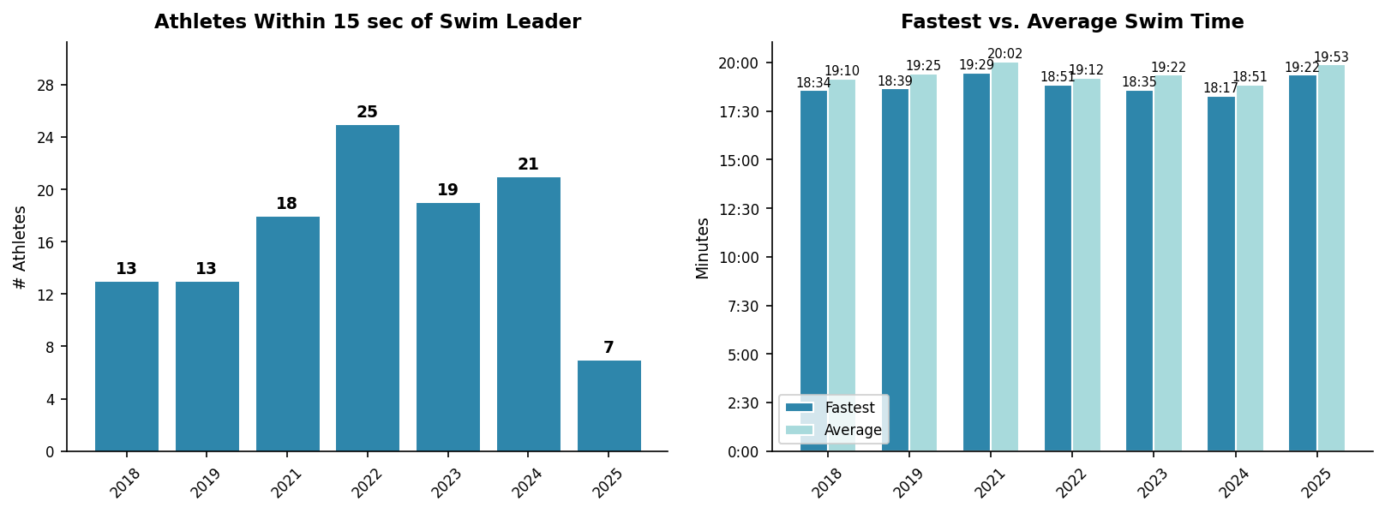
Swim Exit Dynamics — Elite Women
Yokohama

Slide 11
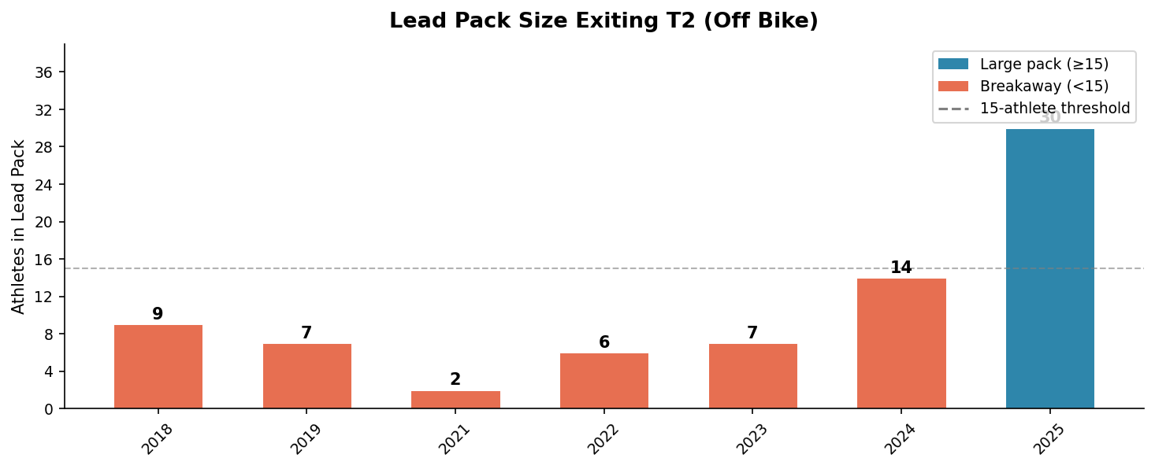
Bike Pack Dynamics — Elite Women
Yokohama

Slide 12
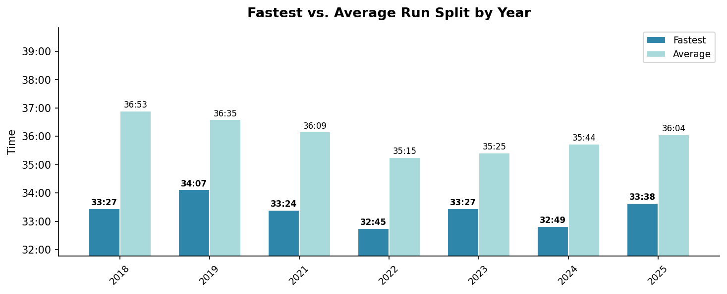
Run Split Analysis — Elite Women
Yokohama

Slide 13
Race Conditions — Elite Women
Yokohama
Year | Air Temp | Water Temp | Wind (km/h) | Wetsuit | Conditions
2018 | 20.1 | — | 9 | — | —
2019 | 19.7 | — | 21 | — | —
2021 | 22.1 | — | 6 | — | —
2022 | 22.0 | — | 15 | — | —
2023 | 17.1 | — | 12 | — | —
2024 | 25.4 | 19.8 | 28 | allowed | —
2025 | 19.8 | 20.2 | 23 | forbidden | —

